Slide 1

NSRIC Inc. (Nature Science Research and Innovation Centre)
Ontario (ON), Canada
Online Education (OE) Division
Essentials of Marketing
Instructor: Kathy Chen
Marketing Program, OE Division
NSRIC Inc.
London, ON, Canada
E-mail: kathyjchen18@gmail.com
https://www.nsric.ca

Slide 2
Week 4: Targeting & Positioning
Content covered in this week:
2.2 Targeting
2.3 Positioning

Slide 3
Week 4: Targeting & Positioning
2.2 Targeting
1. Segmentation and targeting: a rough overview of methods
Once we know our customer segments, we select the segment or segments we want to concentrate on. In other words, we establish what our target market will be. This lesson illustrates with an example the factors to consider when targeting customer segments.
Here is a rough overview of the methods that we have talked about:
1. Attribute importance: What attributes are important? How important?
    Obtain attribute importance ratings, for example, you could ask: ‘How important is Attribute X when you buy…?'
    If there is a long list of attributes, use methods to narrow it down (e.g., factor analysis).
2. Create sub-groups of people based on their similarity regarding these few important attributes. Many methods exist, for example, cluster analysis is one way to do it.
3. Check the validity of the clusters by looking at the random members in the clusters and decide whether they are in the right cluster or not.

Slide 4
Week 4: Targeting & Positioning
2.2 Targeting
A general example: getting the raw data (attribute importance)
Here we have a list of respondents and their ratings regarding the importance of deodorizing power and moisturizing power in a deodorant. We can use this to try and make a plot of similarity between different groups of people.
Respondent Deodorant rating Moisturizing rating
Andy 2 9
Els 3 8
Ozzy 3 2
Lisa 4 5.5
John 7 6
Elise 8 3
Marcus 8.5 8
Qi 9 3.5
Stijn 9 8.8
Stacy 9.5 7

Slide 5
Week 4: Targeting & Positioning
2.2 Targeting
A general example: forming clusters or segments
Now, on this diagram we have plotted each person's requirements of whether they want a highly deodorizing or less deodorizing product, and how moisturizing it should be. What we notice is that Marcus, Stacy and Stijn want their deodorant to be very highly deodorizing and reasonably highly moisturizing, while Qi and Elise don't need it to be very moisturizing. Then, there is a group in the middle with Lisa and John. Overall, we notice five different segments.

Slide 6
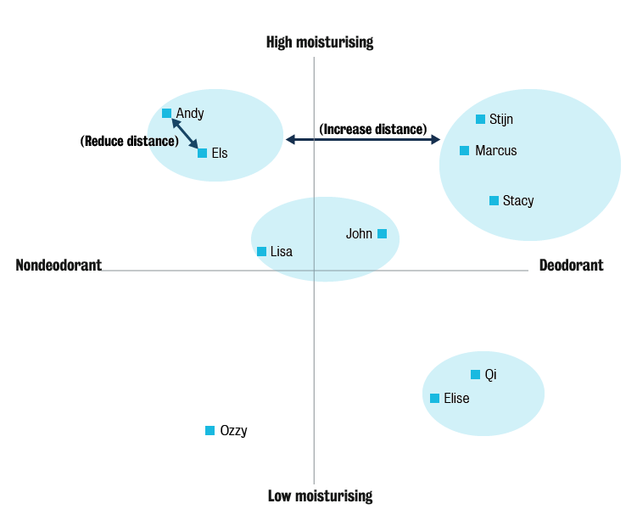
Week 4: Targeting & Positioning
2.2 Targeting
A general example: forming clusters or segments

Slide 7
Week 4: Targeting & Positioning
2.2 Targeting
A general example: forming clusters or segments
From here we can decide which ones we want to target. In order to be successful, we should think about the following:
How big is each of these groups? Is it worth selling to?
Secondly, what do we want to sell to this group? Do we have a highly moisturizing, highly deodorizing product?
If we have two groups, for example, Andy and Els on one side, and Marcus, Stacy and Stijn on the other side, and they all clearly want the same moisturizing level but not the same deodorizing level, can we make two products? Does the firm have the competence to do that?
Is there competition in those areas? Is somebody else trying to provide a product to one of these targets? In this case, we will face competition.

Slide 8
Week 4: Targeting & Positioning
2.2 Targeting
2. Target market selection
If we look at the graphic below, we have the factors to consider when targeting customers, namely:
The market opportunities to profit: that includes the segment size and growth potential. Of course, a segment that will not be available in a few periods from today is not worth targeting.
The competition intensity: is there too much competition targeting the same kinds of customers?
The company ‘fit’: is the firm meeting certain unmet needs? Sometimes it is better to leave a few targets for the competition while we concentrate on other target segments ourselves, and this is where the company fit with our objectives, our competencies, our customer base and the resources we have will come into play.

Slide 9
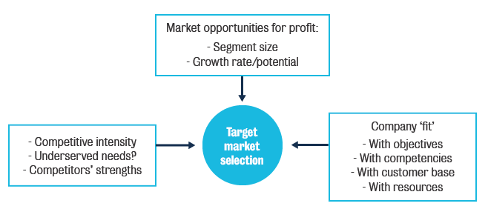
Week 4: Targeting & Positioning
2.2 Targeting
2. Target market selection
In summary, profitability potential, size, fit and access are the criteria for choosing our target segment.

Slide 10
Week 4: Targeting & Positioning
2.2 Targeting
We can illustrate this with the Marriott example. Marriott have a whole set of offerings in the market based on different target groups/segments, so they are indeed targeting multiple groups of people with different needs.
Target | Brand
Upscale hotel | Marriott (Flagship)
Permanent holidaymakers | Marriott Suites
Extended stay | Residence Inns
Business travelers | Courtyards by Marriott
Economy lodging | Fairfield Inns

Slide 11
Week 4: Targeting & Positioning
2.3 Positioning
1. Positioning
Positioning refers to the process of establishing the image or identity of our brand or product so that our targeted consumers perceive it in the way we want. This lesson uses examples to explore common, good positioning strategies.
Examples
In our first example, there are two boxes, one called Conceive and the other called RapidVue. If you walk into a pharmacy, on a shelf near the ovulation testing products, you will find the Conceive brand pregnancy test. The box is pink and it has little baby knits on it. In contrast, a little further down, where the condoms are, you will find another pregnancy test called RapidVue. On that packaging there is no smiling baby, just a plain white box with black lettering.
Both Conceive and RapidVue are from the same company and essentially the same product, but they are positioned for different needs. One is positioned as a positive for people who want to have babies, while the other is about preventing pregnancy.

Slide 12
Week 4: Targeting & Positioning
2.3 Positioning
What are the characteristics of a good positioning statement?
A good positive positioning statement has three components:
1. Who are the target customers?
2. What is it that the product offers?
3. How does it differ from competitors?
Example positioning statement: Amazon
"For World Wide Web users who enjoy books, Amazon.com is a retail bookseller that provides instant access to over 1.1 million books. Unlike traditional book retailers, Amazon.com provides a combination of extraordinary convenience, low prices, and comprehensive selection."
Amazon

Slide 13


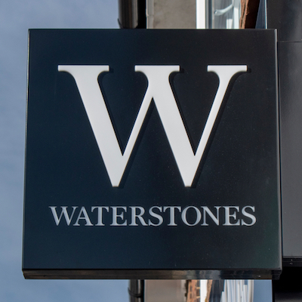
Week 4: Targeting & Positioning
2.3 Positioning
Who are the target customers?
This is an example of a good positioning statement. It has a
clear target: the customers must be web users and the
customers must enjoy reading books.
What is it that the product offers?
'Amazon.com is a retail bookseller that provides instant
access to 1.1 million books.' What it offers is therefore very
clear from the consumer's perspective: it is possible to access
1.1 million books instantly.
How does it differ from competitors?
Unlike traditional book retailers, Amazon.com provides a
combination of convenience, low prices and selection.

Slide 14
Week 4: Targeting & Positioning
2.3 Positioning
The overview is that we select the target segment, determine the relative competitive offerings, understand our potential differentiator dimensions, select the sample of customers in the target segments and move on to developing our messages.

Slide 15
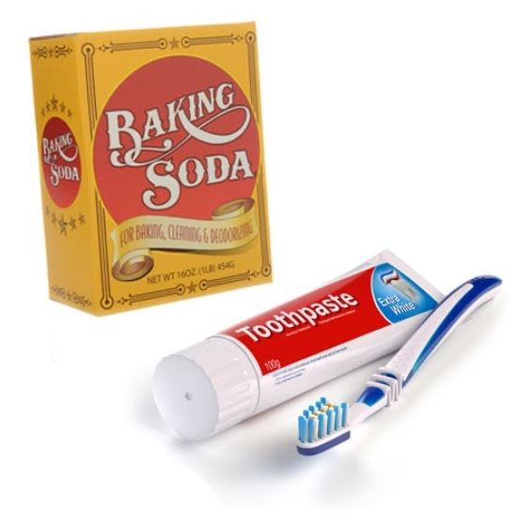
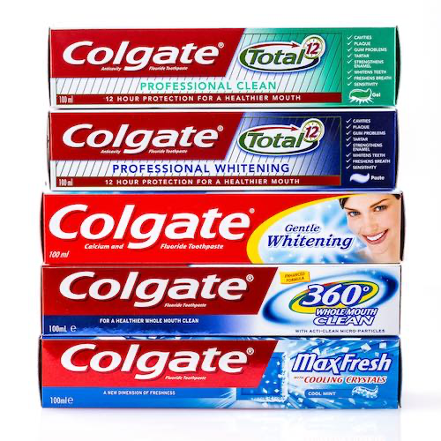
Week 4: Targeting & Positioning
2.3 Positioning
2. Positioning: strategies and examples
Positioning can be by attribute, by benefit, by price or quality, by usage occasion, by product user, with respect to the product category, with respect to a specific competitor or competitors, by emotion or by pre-emption. Let’s see some examples:
Positioning by attribute
If positioning is by attribute, we need to ask: what is it that
the product has? For example, this could be baking soda
toothpaste, or any number of things: food with chocolate, or
some so-called healthy berries, etc.
Positioning by benefit
Next, we have positioning by benefit. This is where the product
is promoted through some kind of advantage that it offers to
the consumer. An example would be Colgate toothpaste,
which provides the benefit of 12-hour dental protection.

Slide 16


Week 4: Targeting & Positioning
2.3 Positioning
2. Positioning: strategies and examples
Positioning by price or quality
We can also position by price or quality. For example, John
Lewis in the UK is a chain of upscale department stores and
Tesco is a chain which has lower priced products. Tesco's
motto is ‘every little helps’, thus implying a price-quality
relationship. John Lewis positions itself as a higher price, but
very good quality retailer, while Tesco positions itself as offering good quality but at a much lower price.
Positioning by use/occasion
If we use usage or occasion for positioning, we market the
product according to the situation, for example, whether the
product is for the daytime or the night-time. Night Nurse is
one of these products. It is taken for flu and fever, but it is
clearly positioned for using at night.

Slide 17
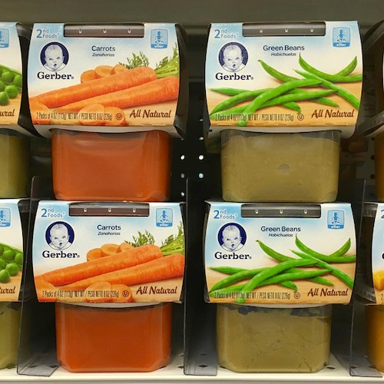
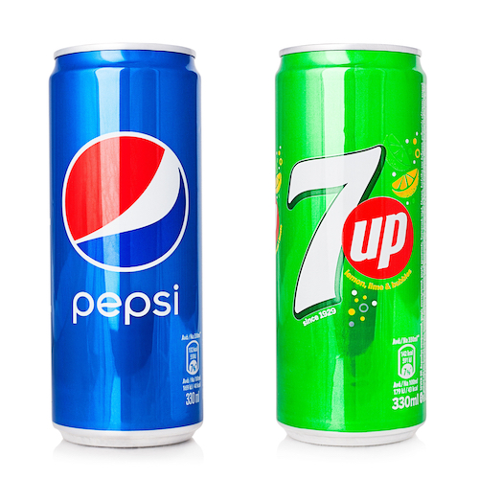
Week 4: Targeting & Positioning
2.3 Positioning
2. Positioning: strategies and examples
Positioning by product user
The user may also allow for different positioning. Gerber
graduates is an example of this. Gerber is a baby food
company and they position their products in their baby food
line according to how many months old the baby is. The user
graduates from being an infant of 0 to 3 months to the next
stage of 3 to 6 months, and so the positioning of each of Gerber's products is based on the growth of the baby.
Positioning by category
Next, we can position by category. For example, in the
carbonated soft drinks market, where caffeinated drinks
have a high market share, 7 Up positioned itself as a cola.

Slide 18
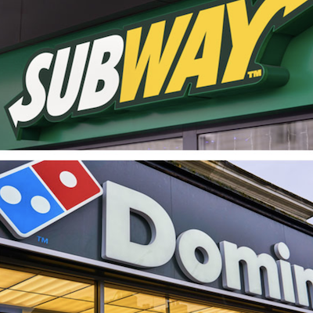

Week 4: Targeting & Positioning
2.3 Positioning
2. Positioning: strategies and examples
Positioning by competitor
Another way to position is directly against the competition.
For instance, Subway has an interesting take on sandwiches
versus Domino’s Pizza.
Positioning by emotion
There is also positioning by emotion, for example, here, NiQuitin is using parental responsibility as an emotional reason to quit smoking. The message in the ad is: if you want to spend more time with your kids, quit smoking with NiQuitin.
Image attribution: NiQuitin

Slide 19

Week 4: Targeting & Positioning
2.3 Positioning
2. Positioning: strategies and examples
Positioning by pre-emption
Positioning by pre-emption means that you are ahead of competitors in communicating a particular feature of the product. An example of this is Listerine, which stops bad breath.
Image attribution: Listerine

